Slide 1
Name: Raneet Laha.
College Roll : CSE[Aiml]/22/055
Project Name: Food Service App
Email: raneetlaha.r2@gmail.com

Slide 2
Contents
About the Project: Food Service Application
Key Features
Frontend Technology: React JS
Backend Technology: Spring Boot (Java)
Database: MySQL
Security: Spring Security with JWT
System Architecture
Future Enhancements

Slide 3
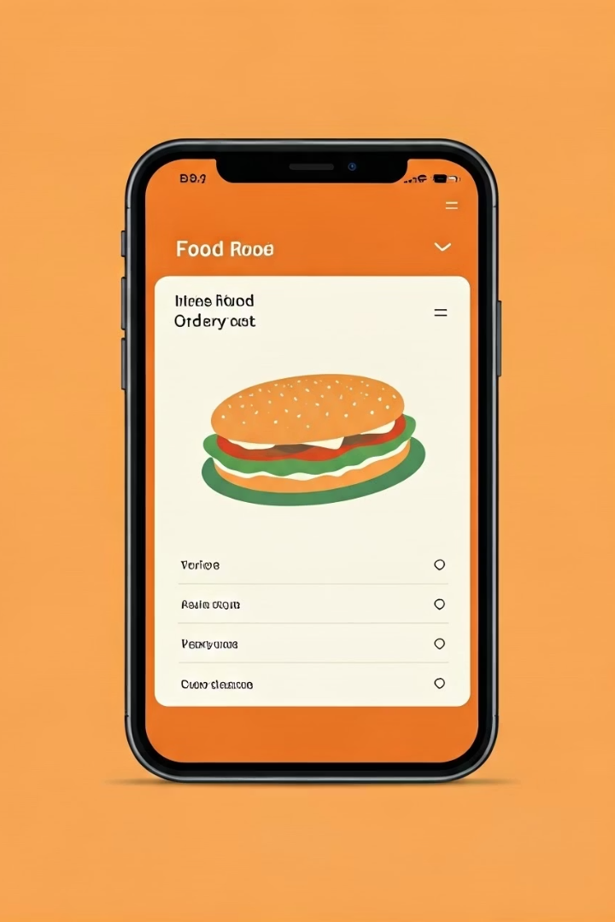
About the Project: Food Ordering Application
A full-stack web app for online food ordering and real-time tracking. It features a REST-based client-server architecture. The system streamlines the ordering process for restaurants and customers.
pg1

Slide 4

Key Features
User Roles
Customer
Admin
Browse menus
Employee
Place orders
Customer
Track status
Manage profile
Admin
Employee
Manage menus, orders, users
Update order statuses
View analytics
Manage delivery assignments
Run promotions
pg2

Slide 5

Frontend Technology: React JS
React JS
REST
Modern UI with Hooks for seamless navigation
Efficient API communication, 99.9% uptime
Bootstrap
Responsive design across all device types
pg3

Slide 6

Backend Technology: Spring Boot (Java)
Spring Boot REST API
Scalable architecture
Robust backend to handle complex requests
Supports over 10,000 concurrent users
Spring Data JPA
Simplifies database interactions and queries
pg4

Slide 7

Database: MySQL
Structured Storage
Optimized Schema
Organizes user and order data efficiently
Enables quick data retrieval with 99.99% availability
Security
Protects sensitive information reliably
pg5

Slide 8
Security: Spring Security with JWT
Spring Security
JWT Authentication
Role-Based Access
Framework for securing APIs and user data
Ensures secure, token-based user verification
Restricts user actions by their assigned roles
pg6

Slide 9





System Architecture
Client
React app sends requests via REST API
Server
Spring Boot handles business logic
Database
MySQL stores orders and user data securely
Security
JWT tokens manage authentication and authorization
pg7

Slide 10
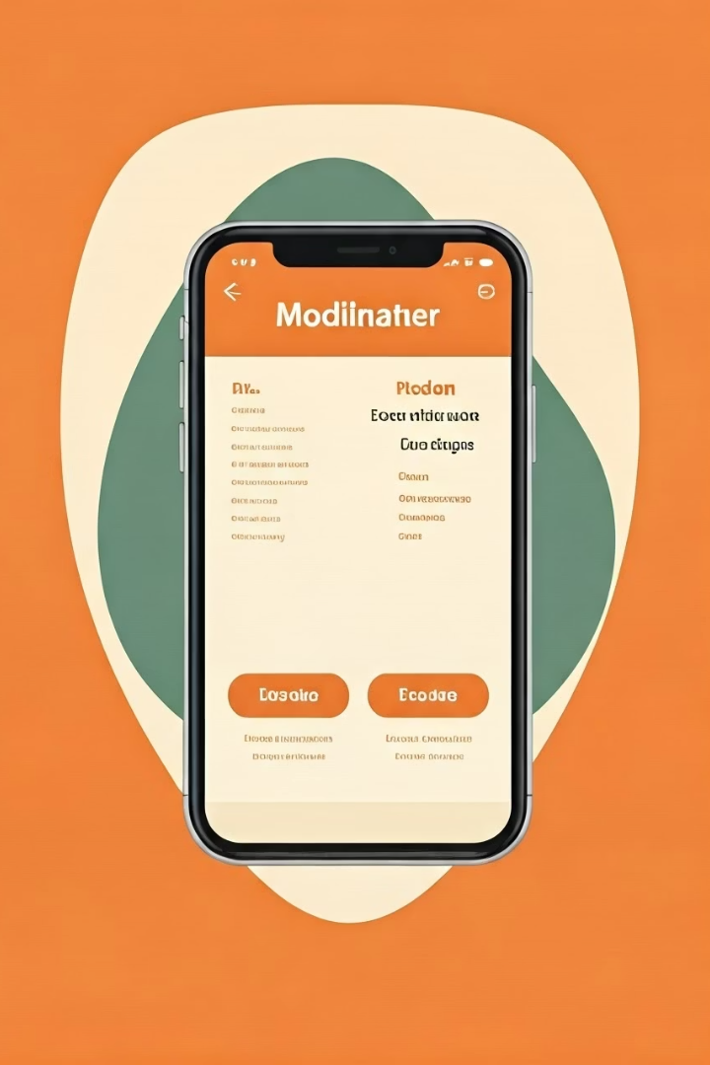
Future Enhancements
Push Notifications
Real-time updates on order status
Payment Integration
Support multiple secure online payment gateways
Reviews & Ratings
Enable customers to provide feedback
Mobile Apps
Develop native iOS and Android applications
pg8

